Slide 1
Pathshala.ai: An Offline Bangla Language Model for High School Education in Bangladesh
A Thesis for B.Sc. in Software Engineering, IICT, SUST

Slide 2
We wouldn’t be here today without the support, guidance and supervision of Dr Ahsan Habib, Associate Professor, IICT, SUST. So, We’d like to begin with a Thank you note - to our supervisor, faculties and board members of this presentation.
Presented by-
Abraar Masud Nafiz and Hamim Rahman

Slide 3
Research background
• Educational disparity in Bangladesh: urban vs rural
• Increasing accessibility of smartphones and cheap devices
• Need for Bangla-specific models
•Problem Description:
• Lack of resources in rural areas
• High computational cost of existing NLP models
• Limited Bangla-oriented tools

Slide 4
Objectives
Develop a Bangla NLP model aligned with the NCTB curriculum.
Optimize for low-resource devices without internet connectivity.
Benchmark performance and usability.
Bridge the education gap with an accessible AI-driven tutor.

Slide 5
Research Significance
Contributes to SDG 4: Quality Education
Addresses linguistic and technological challenges
Provides a scalable solution for rural education
Sets a framework for similar low-resource models globally

Slide 6
Technical Foundations
Core Concepts -
• Transformer-based architectures (e.g., BERT, GPT)
• Challenges specific to Bangla (morphology, syntax, data scarcity)
• Importance of lightweight NLP models.
Optimization Techniques -
• Knowledge distillation
• Quantization
• Sparse attention mechanisms

Slide 7
Before we begin, our first problem was - Data!
Data Sources -
• NCTB textbooks for classes 6–10
• Educational platforms (Shikkhok Batayon with 11k publications, BanglaWiki)
• Practice materials and past exam papers.
Preprocessing Steps -
• Tokenization, normalization, and lemmatization
• Removal of irrelevant content
• Annotation for curriculum alignment

Slide 8
Now, An Overview Of Pathshala.ai

Slide 9
Morphology-aware tokenization, Context-sensitive, Syntax-conscious positional encoding
With BanglaBERT, mBERT, DistilBERT, and GPT-2 Bangla.
Our model has the fast inference time and smaller size while sacrificing quality.
Quantization and Knowledge Distillation
Encoding
Framework
Efficiency
Evaluation
Comparison
•Transformer-based with 12 encoder layers
• Sparse attention for computational efficiency
Performance Metrics -
• Perplexity: 14.2, Accuracy: 70%, BLEU-4: 45.3%
Efficiency Metrics -
• Model size: 120 MB, Inference time: 1.1–10s

Slide 10
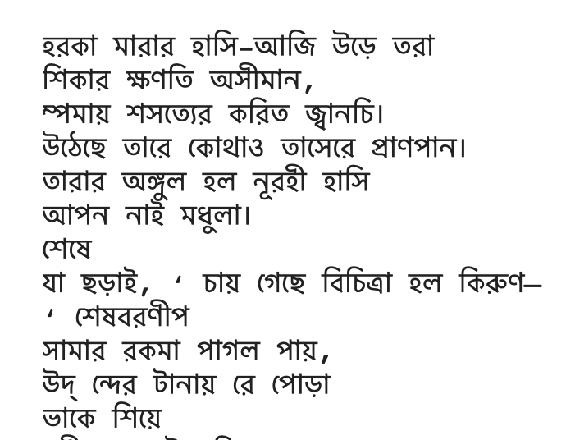
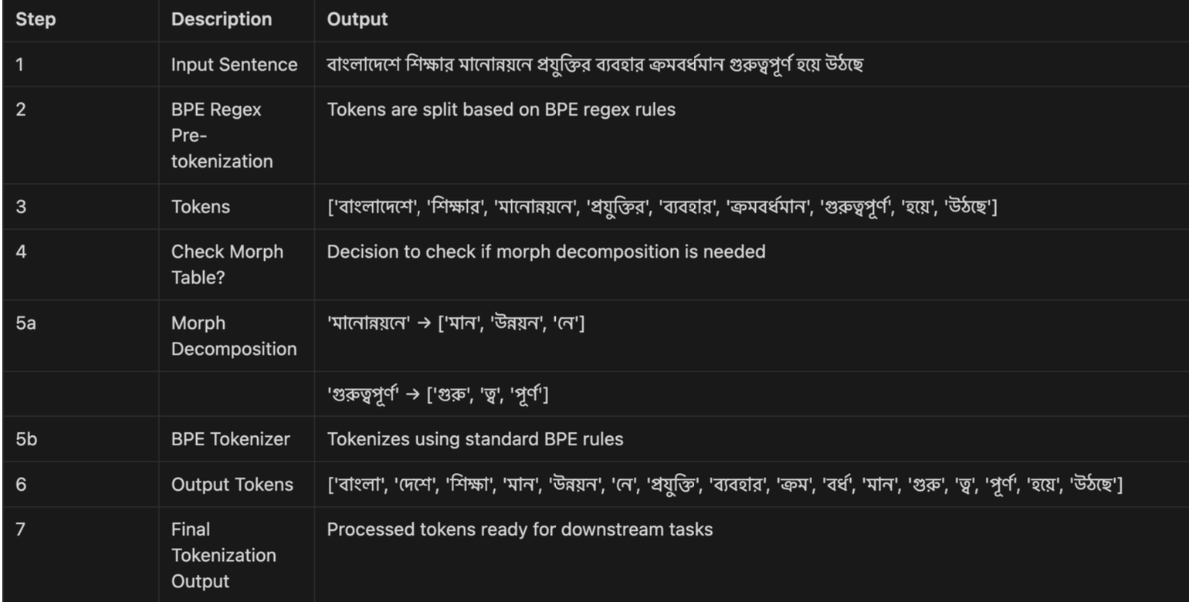
Before and After Custom Tokenization

Slide 11
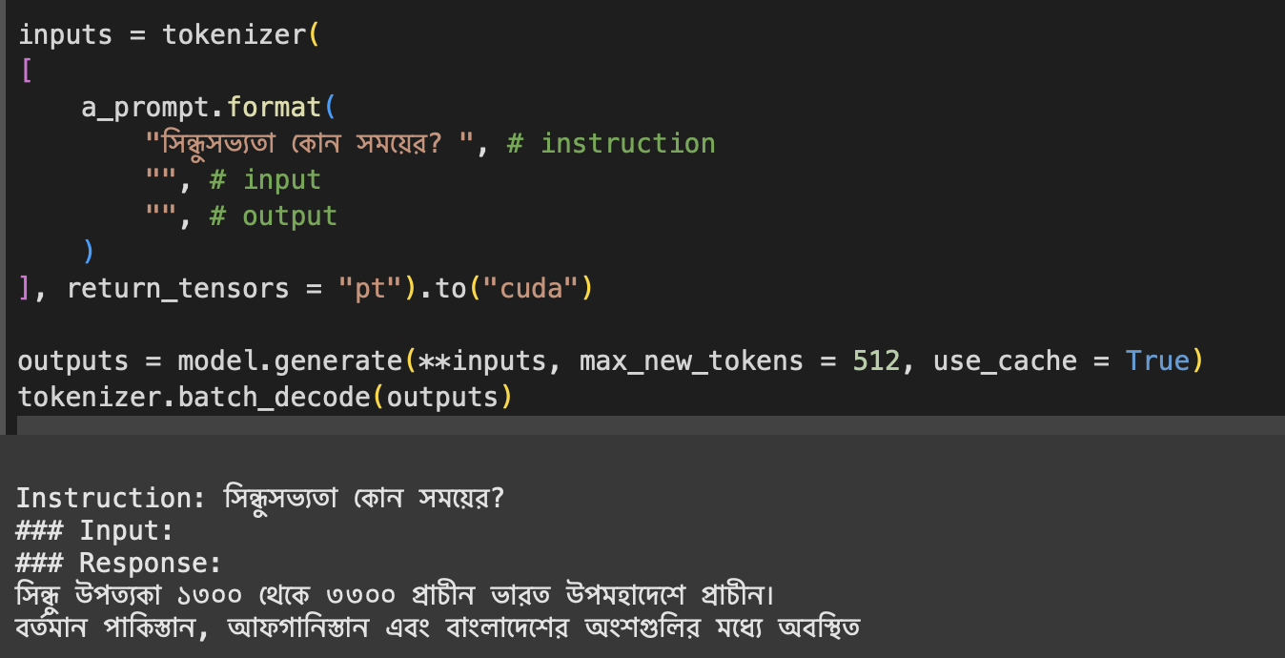
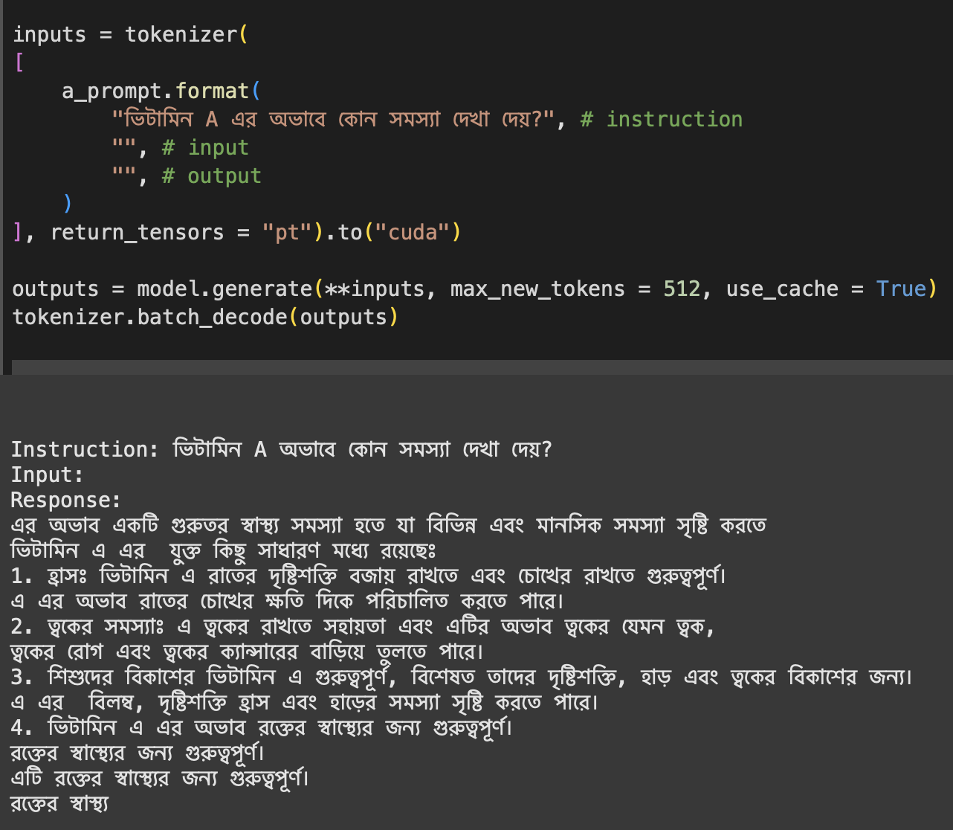
Example Prompts

Slide 12
Performance Overview
Perplexity: Training: 12.5 | Validation: 14.2
Good generalization; reasonable confidence in predictions.
BLEU-1: 78.4%, BLEU-4: 45.3%
Relevance and coherence in generated text.
ROUGE-1: 80.1%, ROUGE-L: 75.3%
Covers key points comprehensively.
Accuracy: 70% overall; Bangla: 92%, Science: 82%, Math: 30%.
Computational Efficiency - Inference Time: 1.1–10s | Peak RAM: 240 MB | Model Size: 150 MB, CPU Utilization: 75% during inference.
Comparative Analysis
• Pathshala.ai vs. Other Models:
• Smaller size (120 MB) and faster (2–10s) with 70% accuracy.
• Comparisons: BanglaBERT (88%, 5.5s), mBERT (82%, 6.0s), GPT-2 Bangla (78%, 7.0s).

Slide 13
Challenges and Limitations
•Poor performance in mathematical reasoning
•Scarcity of training data for some subjects
•Muti-modal Interaction (Which will be our first priority in future)

Slide 14
Future Work
Expand dataset coverage
Enhance numerical reasoning capabilities
Incorporate audio-based features for the visually impaired.
Scale deployment across rural areas
Further optimize model efficiency with advanced techniques

Slide 15
Conclusion
Achievements -
Developed a lightweight, curriculum-aligned Bangla language model
Focusing on rural education with minimal resources, sacrificing everything over computational efficiency.
Impact -
Bridges educational gaps
Offers a scalable framework for low-resource NLP applications
Future Vision -
Transform education for millions of rural students in Bangladesh and beyond.

Slide 16
Thank You!

